Slide 1

BANK LOAN CASE
SWAGATIKA SAMAL

Slide 2

Agenda
Introduction
Tech Stack Used
DataSet Used
Questionnaire
Approach
Conclusion

Slide 3

Introduction
As a data analyst within a finance company specializing in urban lending, this is a task with a critical mission: mitigating the risk posed by applicants with insufficient credit history who default on loans. Through Exploratory Data Analysis (EDA), I was able to scrutinize patterns within the dataset to ensure deserving applicants aren't denied access to financial support.
The company faces dual risks with each loan application:
Rejecting capable applicants, resulting in lost business.
Approving applicants who subsequently default, leading to financial losses.

Slide 4
Introduction
Within the dataset, there are two primary scenarios:
Customers with payment difficulties: Those who exhibited late payments exceeding a threshold on early installments.
All other cases: Instances where payments were made punctually.
Loan applications may culminate in one of four outcomes:
Approval: The company greenlights the loan.
Cancellation: The applicant withdraws during the approval process.
Rejection: The company denies the loan.
Unused Offer: Approval granted but not utilized by the customer.

Slide 5
TECH STACK USED
I have used
Microsoft Excel to solve the questionnaire
Microsoft Power Point to prepare the presentation

Slide 6

QUESTIONNAIRE & APPROACH
Let’s dive in

Slide 7

Data Cleaning
Blanks and unwanted rows were cleaned.
Columns were reduced .
With more than 35 percent null values, columns were deleted.
Few columns with less than 35percent null values, values were replaced with mean or median.
Both the datasets(application_data and previous_application) were merged for further analysis.
Since the datasets are large, few are represented for visualization in this ppt.

Slide 8

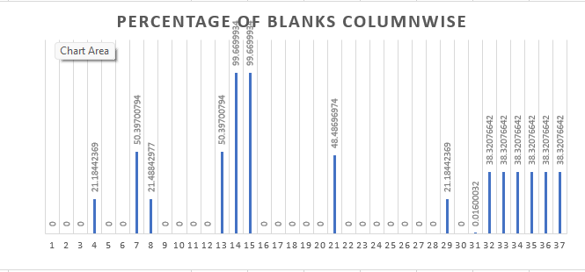
Goals for Q1
Detecting Missing Values
Representation as a graph
The task involves pinpointing the absence of data within the dataset(previous_application) and formulating a suitable strategy to address it utilizing Excel's native functions and capabilities. Excel functionalities COUNTBLANK is deployed to detect missing data instances. Additionally, I have considered MEDIAN for imputation of null values where columns < 35percent null values.

Slide 9
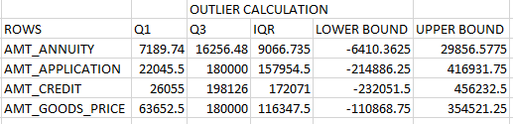
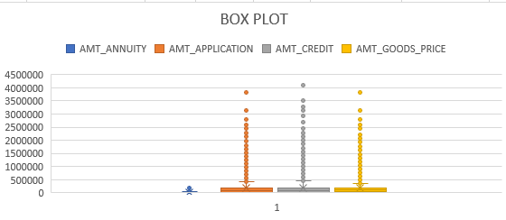
Goals for Q2
Detection of Outliers
Representation as a graph
The task entails identifying and flagging outliers within the dataset by leveraging Excel's statistical functions and features, with a focus on numerical variables. Excel functions such as QUARTILE, IQR, and conditional formatting is employed to pinpoint potential outliers.
Furthermore, I have represented it as a graph (box plot) to represent outliers.

Slide 10
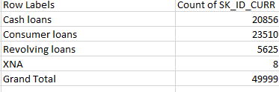
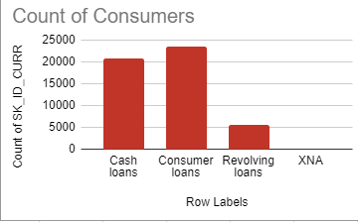
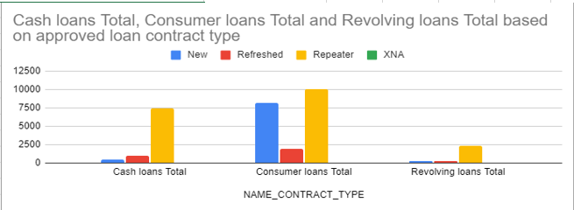
Goals for Q3
Representation as a graph
Data Imbalance
The objective is to assess whether there is a data imbalance within the dataset and compute the ratio of this imbalance using Excel functions.
I have used pivot table to represent data imbalance in previous_application dataset in the form of graph.

Slide 11
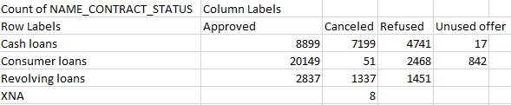
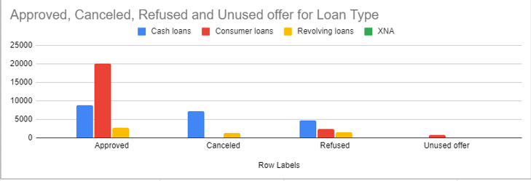
Representation as a graph

Slide 12
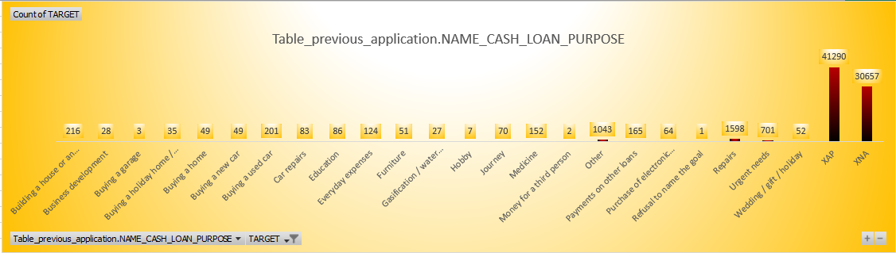
Goals for Q4
Univariate, Segmented Univariate, and Bivariate Analysis
Initially, I consolidated the two datasets: application data and previous application, following the application of appropriate cleaning techniques to ensure accurate visualization.
Then, I conducted univariate analysis to comprehend the distribution of individual variables, segmented univariate analysis to compare variable distributions across different scenarios, and bivariate analysis to investigate relationships between variables and the target variable using Excel's functions and features.

Slide 13
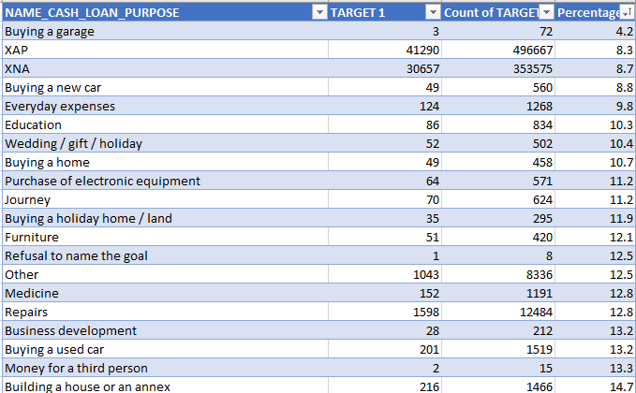
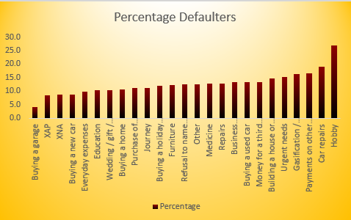
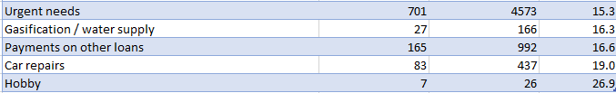
Representation as a graph
Univariate, Segmented Univariate, and Bivariate Analysis

Slide 14
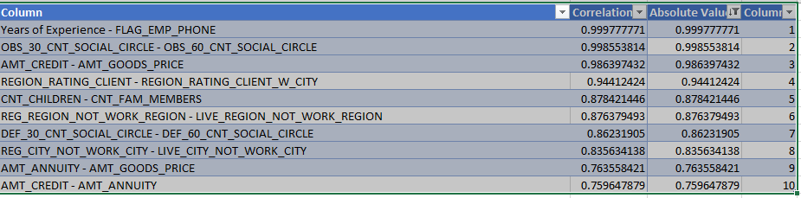
Goals for Q5
Correlation
I have divided the dataset into segments based on various scenarios (e.g., clients with payment difficulties and all other cases) and determined the most significant correlations within each segmented data using Excel functions. I have utilized functions like CORREL to compute correlation coefficients between variables and the target variable within each segment. Then, ranked these correlations to pinpoint the primary indicators of loan default for each scenario.
Top 10 Repayers’ Correlation

Slide 15
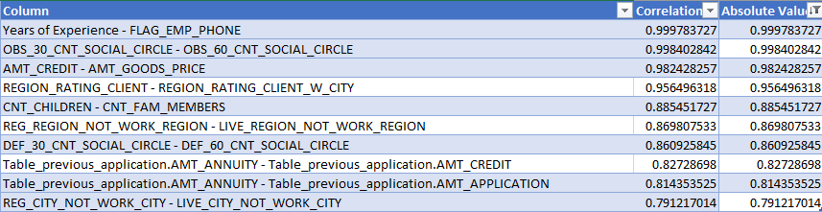
Goals for Q5
Correlation
Top 10 Defaulters’ Correlation

Slide 16

In conclusion, the primary objective of this project is to uncover patterns signaling potential challenges for customers in meeting their installment payments. This insight serves as a basis for critical decisions, including loan denial, loan amount reduction, or offering loans at elevated interest rates to higher-risk applicants. By comprehending the pivotal factors contributing to loan defaults, the company aims to enhance its loan approval process and make more informed decisions.

